Slide 1


Data Governance @ SneakerPark
Prepared by: The Code on the Street.
Submitted on:

Slide 2
Background
SneakerPark is an online shoe reseller that allows people to buy and sell used and new shoes. Buyers can bid for shoes or buy them outright, and sellers can set a price or sell to the highest bidder.
Each buyer and seller must have an active account in order to sell, bid, or purchase sneakers using SneakerPark’s website.
SneakerPark authenticates the shoes before shipping them to the buyer, so before listing an item, the seller must ship it to SneakerPark’s warehouse. Upon receipt, SneakerPark assigns an item number to each pair of sneakers and notifies the seller that they are now free to list their item. If the item is not listed within 45 days, SneakerPark returns it to the seller and sends an invoice to the seller for the shipping cost.
If the item is found to be inauthentic or in an unacceptable condition, it is also returned back to the seller in a similar fashion.
When the item sells, the buyer’s account is credited with the purchase price minus the SneakerPark service fee and shipping fees to deliver the item to the buyer.
Currently, SneakerPark only supports sales within the United States.

Slide 3
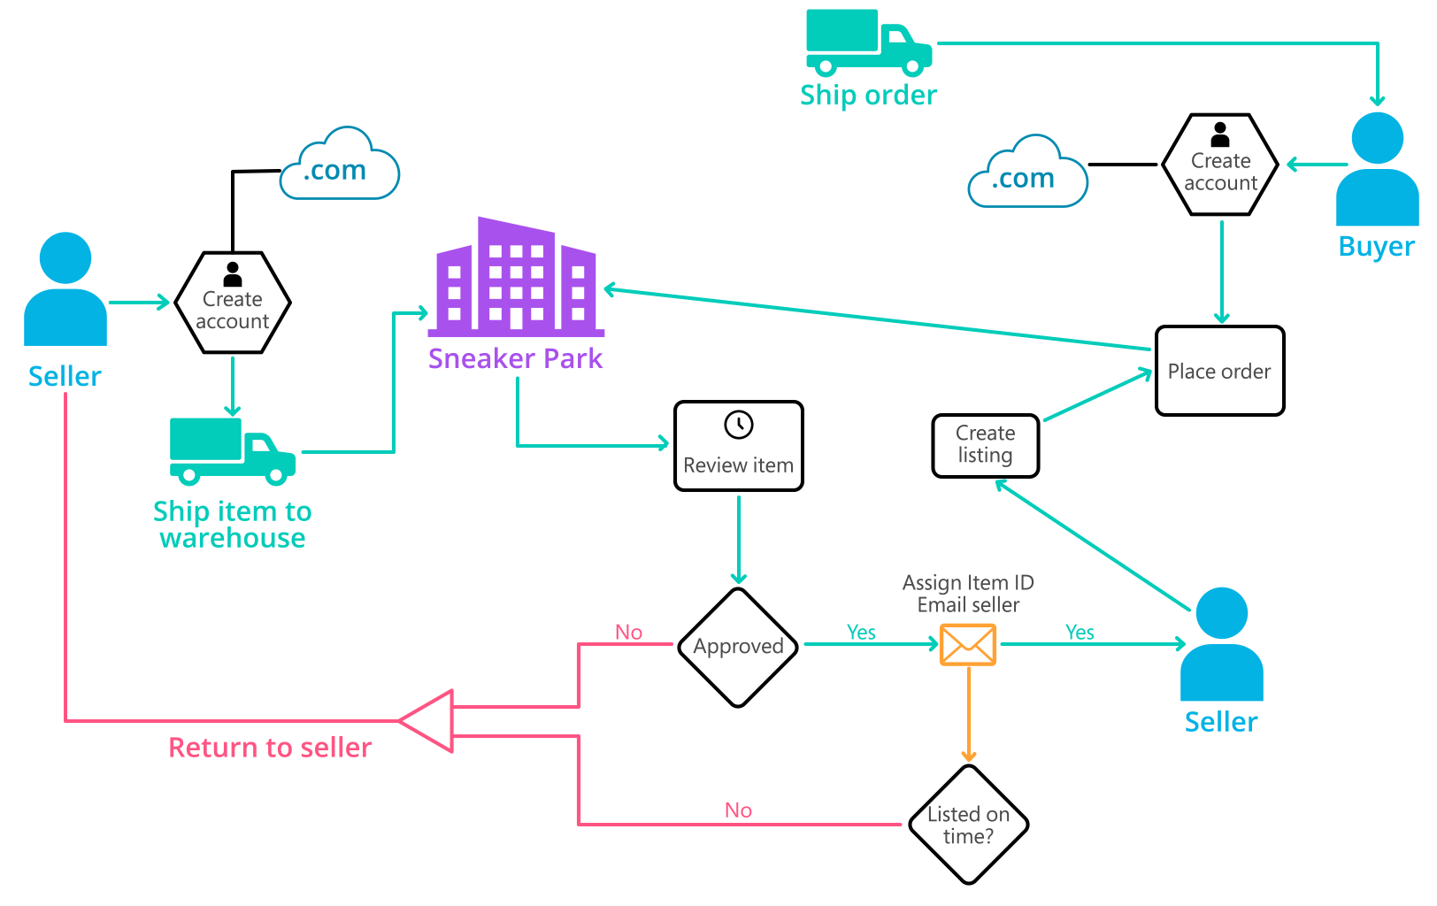
Background (cont’d)
Below you can see a diagram that will hopefully help you visualize some of SneakerPark's business processes. Keep in mind that it does not capture ALL processes and every nuance, but simply serves as another artifact to use in your project.

Slide 4
Step 1
Enterprise Data Catalog Part 1: Enterprise Data Model

Slide 5
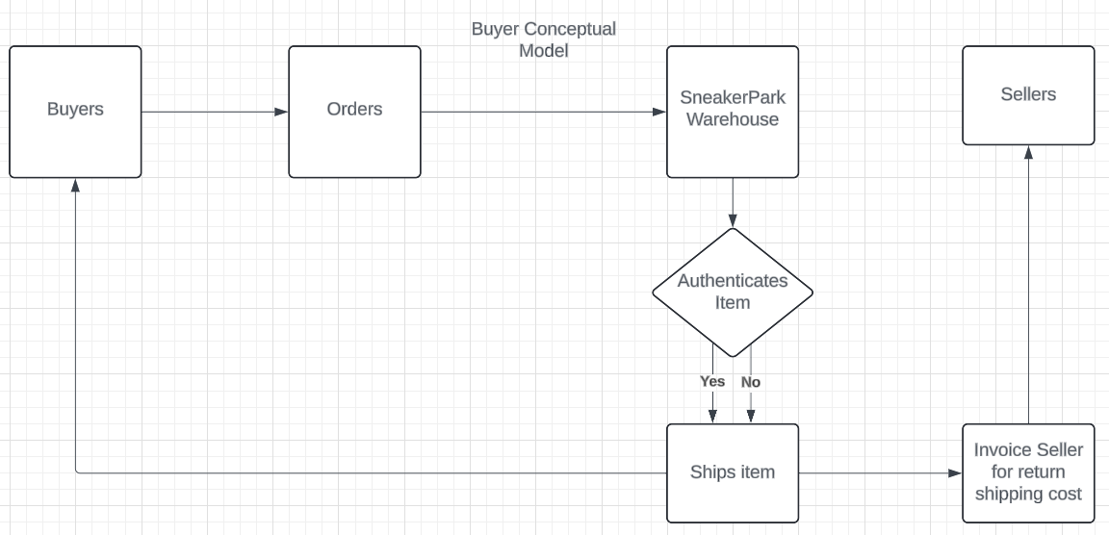
Buyer Conceptual Data Model

Slide 6
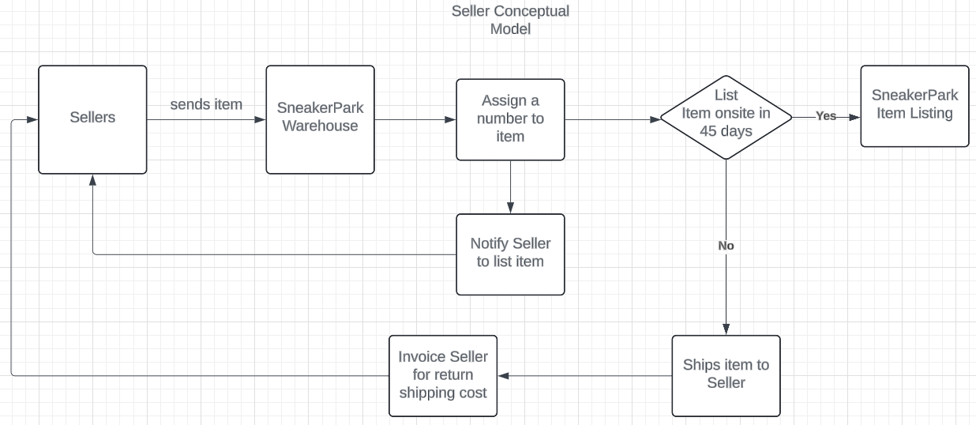
Seller Conceptual Data Model

Slide 7
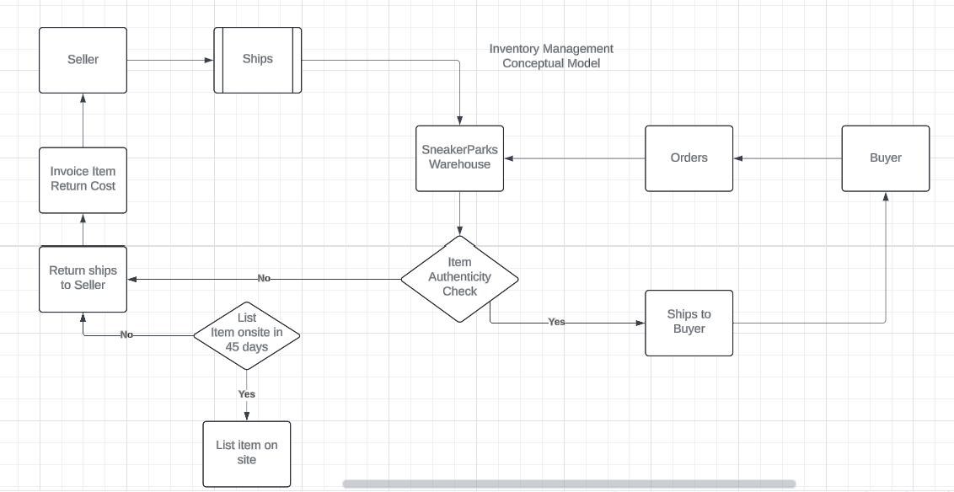
Inventory Management Conceptual Model

Slide 8
Step 2
Enterprise Data Catalog Part 2: Metadata

Slide 9
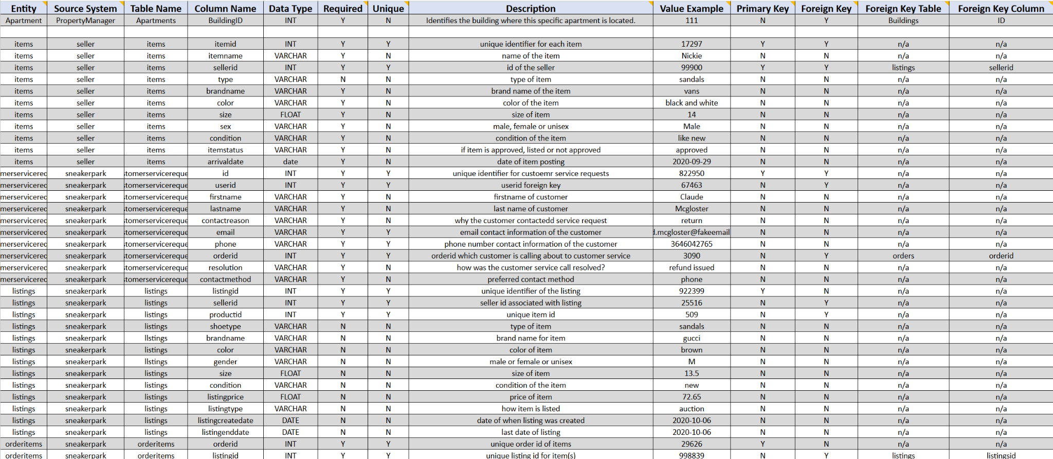
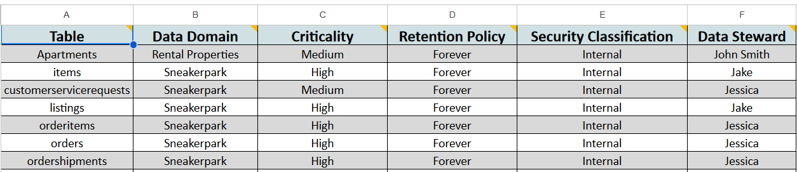
Create the first version of the Metadata Catalog by documenting the metadata from all systems in the "Data Dictionary" and the “Enterprise Data Catalog” tabs of the provided Sheets template.
Please note that you are required to fill out all fields in both tabs.

Slide 10
Step 3
Data Quality
Part 1: Profiling and Cleansing

Slide 11
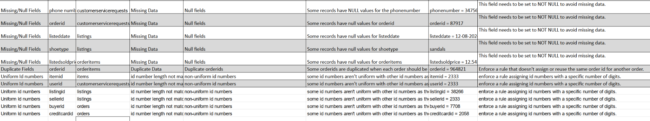
Profile the data to identify at least 3 data quality issues you see in the data. Also provide at least 1 data quality issue that you haven’t yet seen in the data, but can foresee occurring in the future. Based on the issues you’ve identified, come up with the data quality rule for each data quality issue, including for the one that you foresee.
Make sure you fill out all columns in the "Data Quality Issues" tab with your answers in the provided Sheets template.

Slide 12
Step 4
Data Quality
Part 2: Monitoring

Slide 13
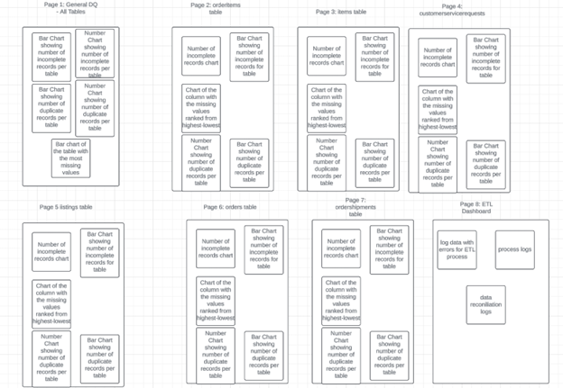
Monitoring Dashboard

Slide 14
Step 5
Master Data Management
Part 1: MDM Architecture

Slide 15
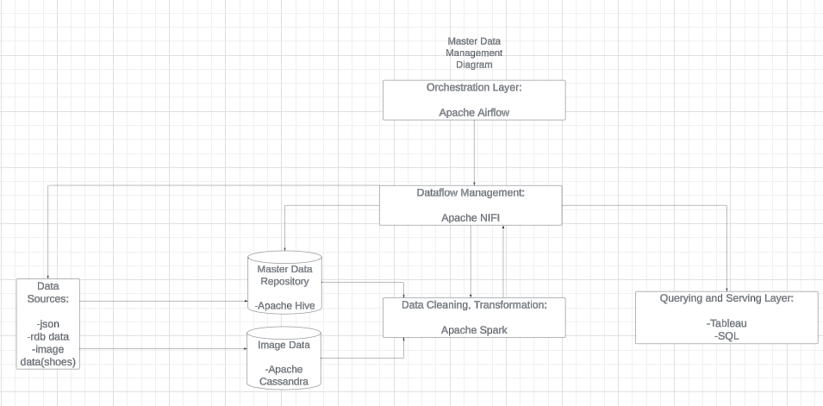
MDM implementation architecture

Slide 16
Explanation:
Data Source Layer:
Data Source:
Customer service request data
Item data
Listings data
Orders data
Orderitems table
Ordershipments
DataTypes/Formats:
Json
Relational database table data
Image data(shoes images)
Tools:
Apache NIFI for dataflow management
Data Storage Layer:
Datawarehouse: Apache Hive
Apache Cassandra
To host image data
Processing Layer:
Apache Spark:
Use spark to clean, transform and process the data before storing it back into a database
Orchestration Layer:
Apache Airflow: Use Apache Airflow to orchestrate all your data pipeline schedules
Querying and Serving Layer:
Tableau: Dashboarding frontend
SQL: RUnning queries to create static and custom report
Set of Matching Rules for Sneakerpark’s MDM Architecture Hub:
Match records based on unique identifiers like customerID or any id column for each of the tables when running queries. Using unique identifiers allow for the most accurate way to match records.
Enforce matching between records when first name/last name, email, phone number or other unique fields match.
More examples: birthday, address/zip code, sku number, price.
Use fuzzy matching to take account variations in the data entry process.

Slide 17
Step 6
Master Data Management
Part 2: Master Record

Slide 18
MDM Matching Rules
Items:
Match items based on the exact match of the unique identifiers like itemid as this is to ensure reliability.
Match items based on brand, model and size as well. This enhances the assurance that the item with a itemid matches what the consumer or seller are looking for.
Customers:
Match customer records based on a unique identifier such as customerid.
Match customer records by first name, last name, email, and/or phone number. This provides a strong basis for identifying the same person across multiple systems.

Slide 19
Step 7
Data Governance:
Roles and Responsibilities

Slide 20
Data Governance Roles & Responsibiliites
Data governance is important for ensuring the success of Sneakerpark’s data management initiative. Roles and responsibilities must be clearly defined which will oversee data quality, consistency and compliance to law and business regulations. Have the Chief Data Officer lead the data governance initiative by providing the strategic direction for data policies, effective implementation, managing datasets, and driving data-driven decisions across the organization.Data Stewards can also assist with daily data management and oversight. They can enforce data quality rules, ensure data accuracy, and collaborate with other team members/stakeholders to resolve data issues.
Data Quality Analysts can monitor data quality metrics, perform data profiling/ data quality checks, and identify data anomalies. I.T and Data Management Teams provide technical support for data governance initiatives which include maintaining data infrastructure, implementing data integration, ETL processes, and data security.

Slide 21
Standout Suggestions

Slide 22
Create a Business Glossary for SneakerPark and define common terms such as Item, Buyer, etc. Think and discuss how SneakerPark can improve on the consistency of the terms that its systems currently use. (You can use the “Business Glossary” tab of the same Sheets template you’ve been using for the other parts of this project to get you started.)
Document SneakerPark’s current naming conventions. Can you think of any improvements? (You can use the “Standard Naming Conventions” tab of the same Sheets template you’ve been using for the other parts of this project to get you started.) Some examples of Naming Conventions include;
Do not use spaces or special characters.
Use only LOWERCASE.
All identifier fields should end in “_id”.
Avoid acronyms and abbreviations.
Write SQL scripts for the matching rules that you’ve created in Step 6.

Slide 23
Business Glossary
Item:
Definition: A product listed for sale on SneakerPark’s platform, including new and used shoes.
Attributes: ItemID, Brand, Model, Size, Condition, AuthenticityStatus, ListedPrice, SKU, Description.
Buyer:
Definition: A registered user who purchases items from SneakerPark’s platform.
Attributes: BuyerID, FirstName, LastName, Email, Phone, Address, PaymentMethod, AccountStatus.
Seller:
Definition: A registered user who lists items for sale on SneakerPark’s platform.
Attributes: SellerID, FirstName, LastName, Email, Phone, Address, PaymentMethod, AccountStatus
Order
Definition: A transaction in which a buyer purchases one or more items from a seller through SneakerPark’s platform.
Attributes: OrderID, BuyerID, SellerID, ItemID, PurchasePrice, ServiceFee, ShippingFee, OrderStatus, DateOrdered, DateShipped.
Service Request
Definition: A request made by a buyer or seller to SneakerPark’s customer service for assistance.
Attributes: RequestID, UserID, FirstName, LastName, ContactReason, Email, Phone, OrderID, Resolution, ContactMethod.
Order Shipping
Definition: The process of sending purchased items from the seller to the buyer.
Attributes: ShipmentID, OrderID, ItemID, ShippingAddress, ShippingStatus, DateShipped, DateDelivered, ReturnStatus, ReturnReason, DateReturned.

